Slide 1

WIPRO NGA Program – 25SUB4530_CP_JAVA
Capstone Project Presentation – 9th Feb & 10th Feb 2026
Project Title Here – Online Book Store
Presented by – Enuguru Charitha Sree ,G.Mohan Sri Sai (TEAM-6)
www.rpsconsulting.in

Slide 2

Online Book Store
Introduction :
The Online Book Store is a web-based catalog management application developed to manage book information in an efficient, secure, and structured manner.
The Online Book Store is a web-based catalog management application developed to manage book information in an efficient, secure, and structured manner.
The system is built using Angular for the frontend, Spring Boot for the backend, and a relational database such as MySQL or PostgreSQL for data storage. It follows a RESTful API-based architecture and is containerized using Docker for scalable deployment on Microsoft Azure.
2024 - RPS Consulting all rights reserved

Slide 3
Online Book Store
Problem Statement :
In many book stores, book catalog and inventory details are still managed using spreadsheets or manual registers, which leads to:
Data redundancy and inconsistency in book information.
Difficulty in searching books by title or author.
Higher chances of human errors in stock and price updates.
Lack of centralized access control and data security.
Time-consuming processes for updating and maintaining book records.
There is a need for a robust, secure, and scalable online book store system that enables efficient management of book catalog, and user interactions with minimal manual effort.
2024 - RPS Consulting all rights reserved

Slide 4
Online Book Store
Objectives:
The key objectives of the Online Book Store system are:
To maintain book records in a centralized database
To reduce manual errors in managing book details, pricing, and stock
To provide quick search and update functionality for books
To ensure data accuracy and proper validation of book information
To implement a scalable and maintainable system architecture
To provide a user-friendly and responsive web interface
2024 - RPS Consulting all rights reserved

Slide 5
Online Book Store
Core Functionalities:
The system provides the following core functionalities:
Add new book records to the catalog
View book details such as title, author, price, and stock in an organized format
Update existing book information
Delete book records from the catalog
Search books by title or author
Perform input validation on both frontend and backend
Handle errors using global exception handling mechanisms
All operations are performed using RESTful APIs, ensuring loose coupling between the frontend and backend.
2024 - RPS Consulting all rights reserved

Slide 6
Online Book Store
Key Features:
User-friendly and responsive interface developed using Angular
Reactive forms with proper validation for book and user inputs
RESTful APIs to support CRUD operations on book catalog
Global exception handling implemented in the backend
Search and filter functionality for books by title or author
Secure database interaction using Spring Data JPA
Scalable and containerized deployment using Docker and Microsoft Azure
2024 - RPS Consulting all rights reserved

Slide 7
Online Book Store
RESTful API-Based Architecture:
The project follows a RESTful API architecture, where:
Each operation is mapped to an HTTP method:
POST → Add Book
GET → View Book(s)
PUT → Update Book
DELETE → Delete Book
APIs return JSON responses
Stateless communication is maintained
Clear separation between frontend and backend
This architecture improves scalability, maintainability, and reusability of the application.
2024 - RPS Consulting all rights reserved

Slide 8
Online Book Store
Technology Stack:
1.Frontend
Angular
TypeScript
HTML, CSS, Bootstrap
2.Backend 4. DevOps & Deployment
Spring Boot - Docker (Containerization)
Spring Data JPA - Microsoft Azure App Service
REST APIs
3.Database
H2 / PostgreSQL
2024 - RPS Consulting all rights reserved

Slide 9
Online Book Store
User Interface:
Dashboard with navigation menu
Add Book form with proper validations
Book List view in an organized layout
View Book details page
Update Book form
Search books by title or author
The user interface updates in real time when book records are added, updated, or deleted, providing a smooth and responsive user experience.
2024 - RPS Consulting all rights reserved

Slide 10
Online Book Store
Application Workflow:
User opens the application
User logs in as USER or ADMIN
User navigates to the Add Book or Book Management page
User enters book details
Form validation occurs on the frontend
Data is sent to the backend through REST APIs
Backend validates and processes the request
Data is stored in the database
Book list is refreshed automatically
User can view, update, or delete book records based on role
This ensures efficient and real-time management of the online book s tore system.
2024 - RPS Consulting all rights reserved

Slide 11
Online Book Store
DevOps & Deployment:
Docker:
Containerizes frontend and backend applications
Ensures consistent environment across development and production
Simplifies deployment process
Azure:
Hosts backend Spring Boot APIs
Hosts Angular frontend application
Supports scalability and cloud deployment
Enables easy application management.
2024 - RPS Consulting all rights reserved

Slide 12
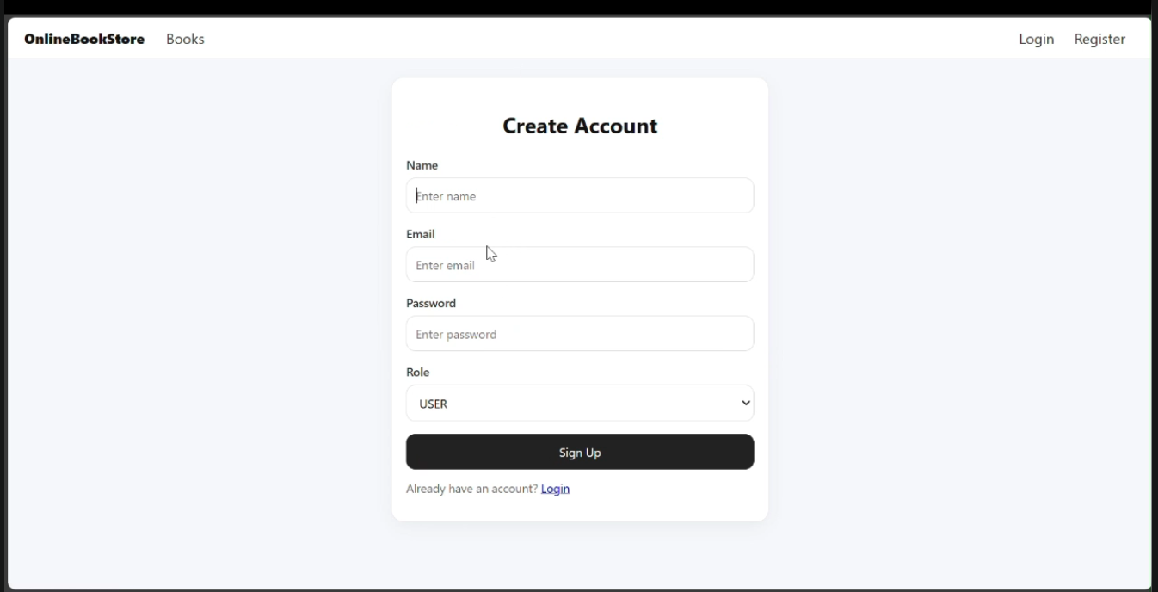
Online Book Store
Register Page:
2024 - RPS Consulting all rights reserved

Slide 13
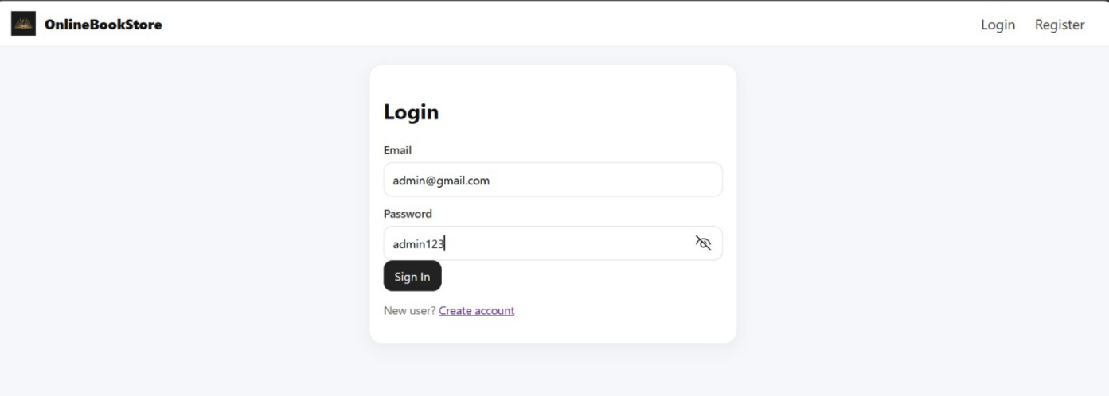
Online Book Store
Login Page:
2024 - RPS Consulting all rights reserved

Slide 14
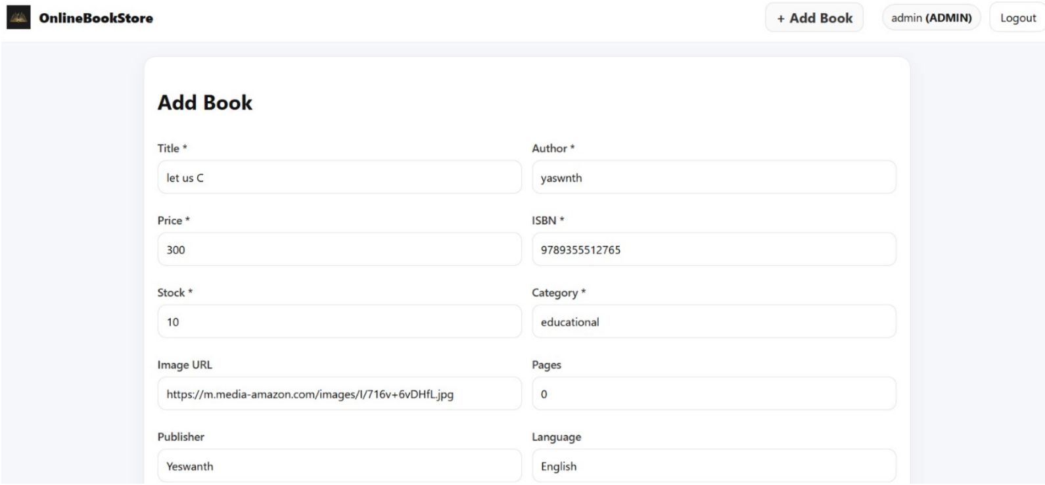
Online Book Store
Adding Book Page:
2024 - RPS Consulting all rights reserved

Slide 15
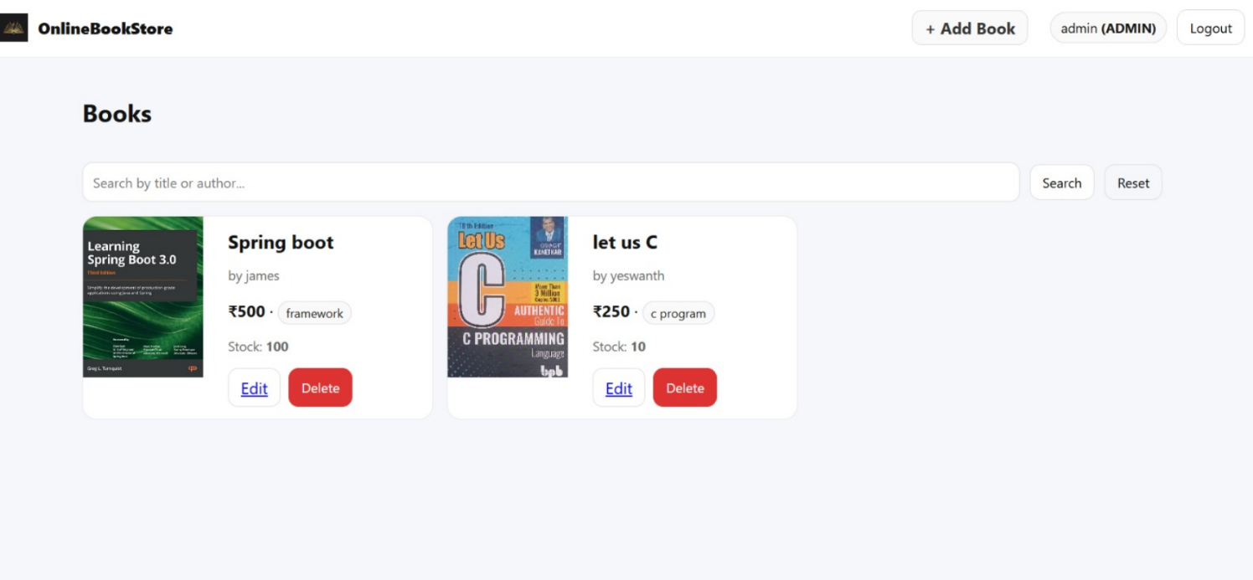
Online Book Store
Book List Page:
2024 - RPS Consulting all rights reserved

Slide 16
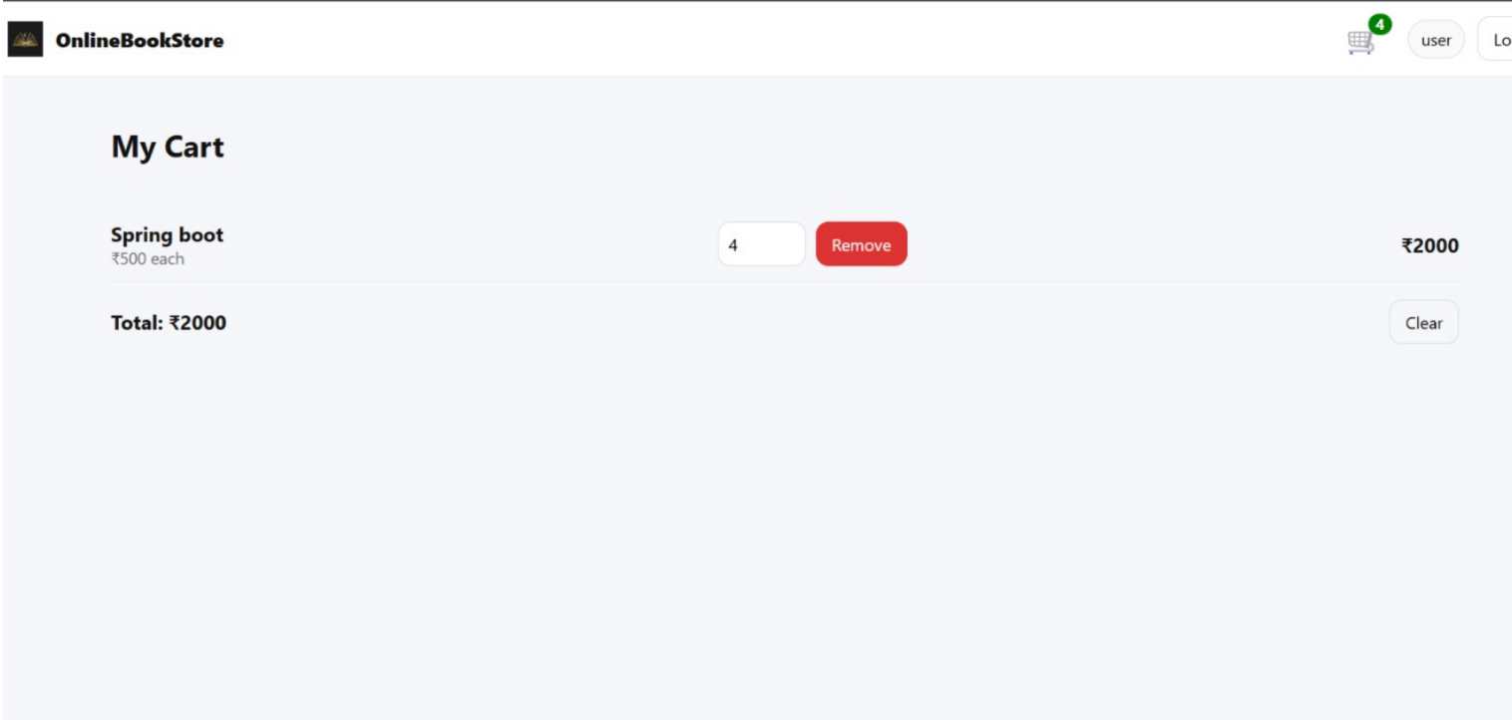
Online Book Store
Add to cart Page:
2024 - RPS Consulting all rights reserved

Slide 17
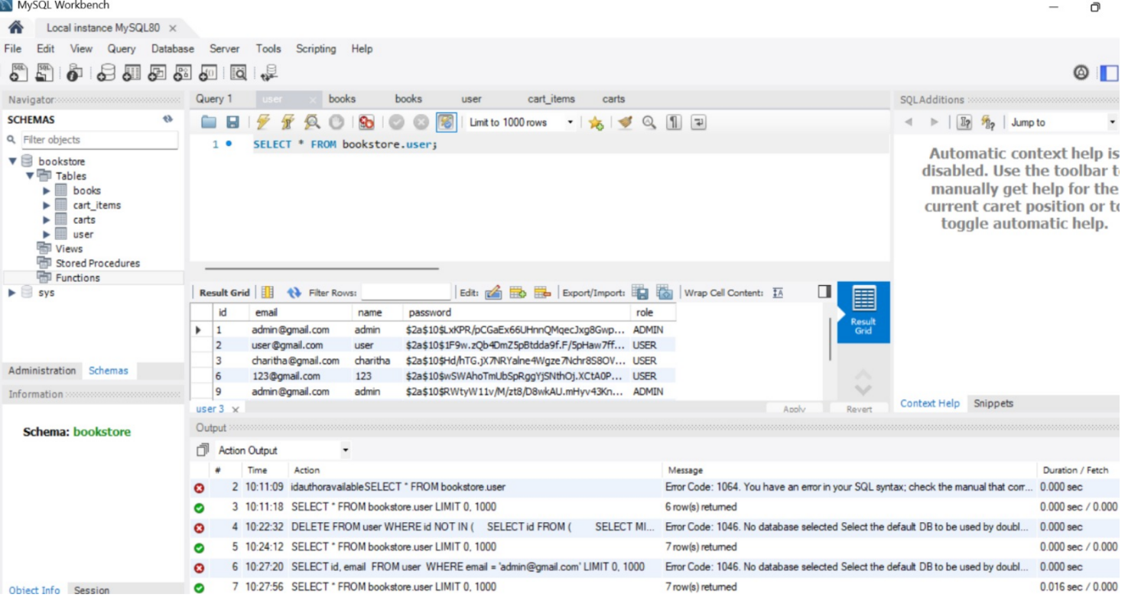
Online Book Store
User’s Data in DB :
2024 - RPS Consulting all rights reserved

Slide 18
Online Book Store
User’s Data in DB :
2024 - RPS Consulting all rights reserved

Slide 19
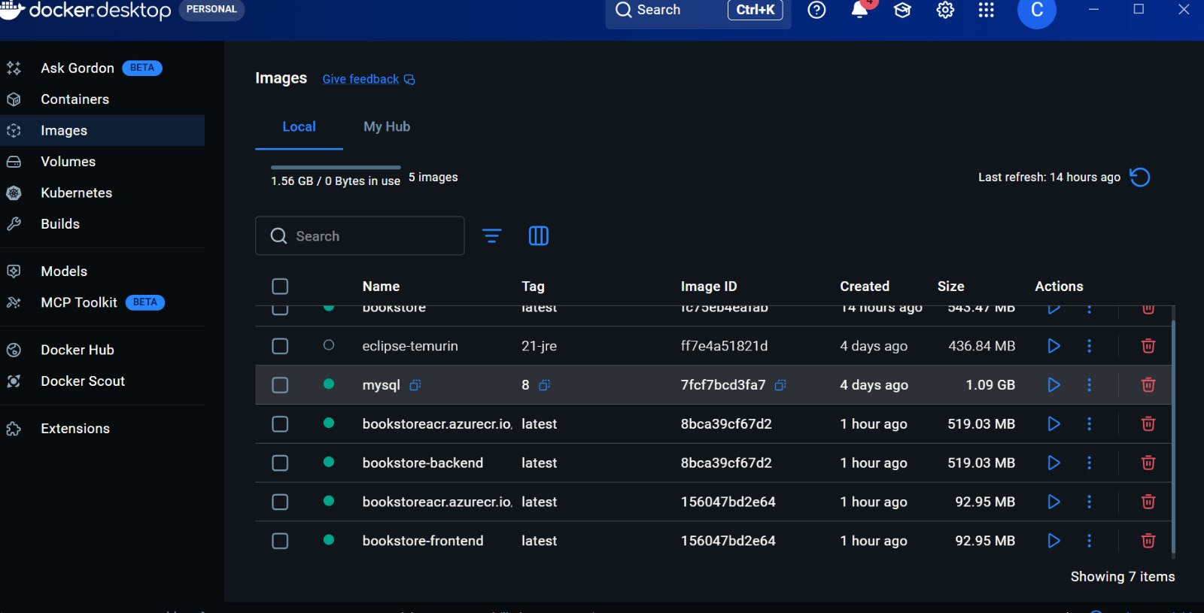
Online Book Store
Container running in Docker :
2024 - RPS Consulting all rights reserved

Slide 20
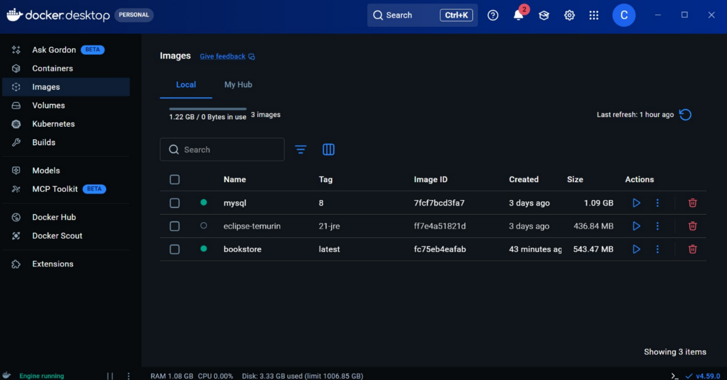
Online Book Store
Images created in Docker :
2024 - RPS Consulting all rights reserved

Slide 21
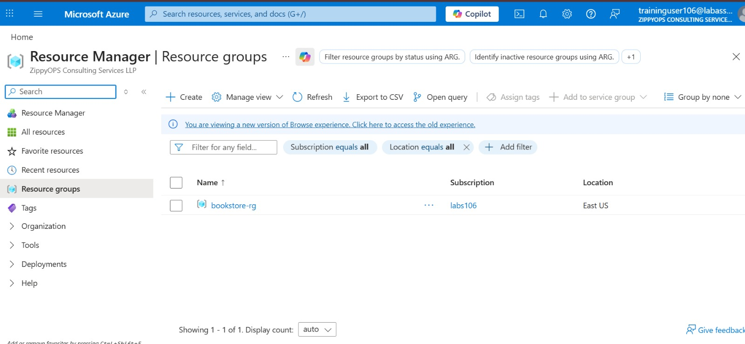
Online Book Store
Database In Azure :
2024 - RPS Consulting all rights reserved

Slide 22
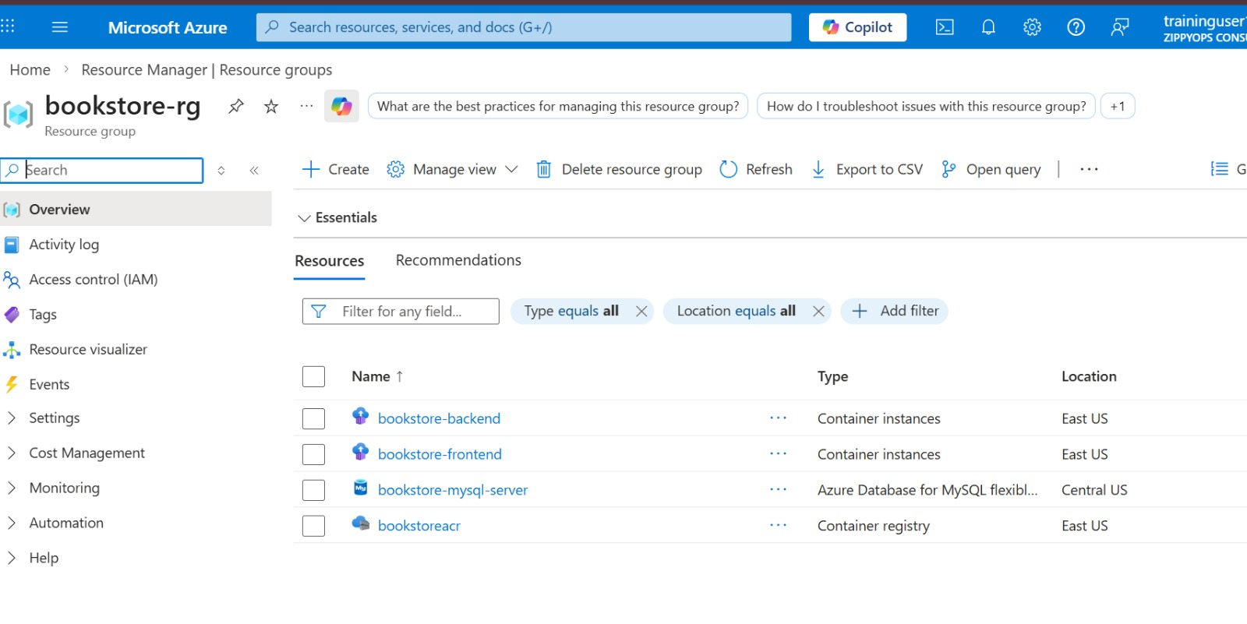
Online Book Store
2024 - RPS Consulting all rights reserved

Slide 23
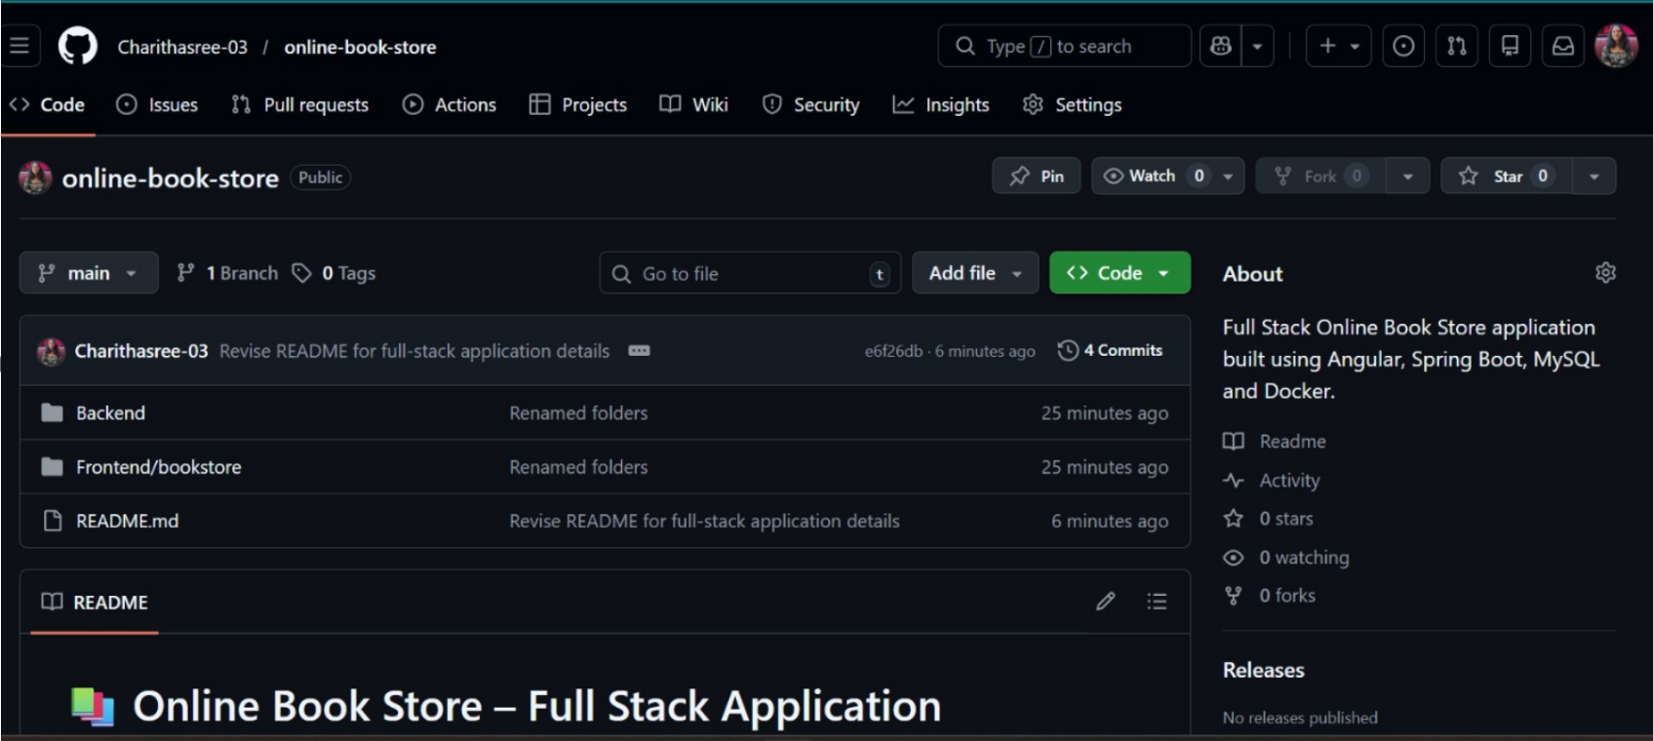
Online Book Store
Project pushed into GitHub
2024 - RPS Consulting all rights reserved

Slide 24
Online Book Store
Conclusion:
The Employee Management System provides an efficient way to manage employee records digitally.
It supports CRUD operations with secure and validated data handling.
Angular delivers a responsive and interactive user interface.
Spring Boot with RESTful APIs handles backend business logic efficiently.
The database ensures reliable data storage and quick retrieval.
Deployment on Docker and Microsoft Azure enables scalability, reliability, and cloud readiness.
2024 - RPS Consulting all rights reserved

